Slide 1
Retro Golf game
Final Presentation
Matthew Fish
03/05/2024

Slide 2
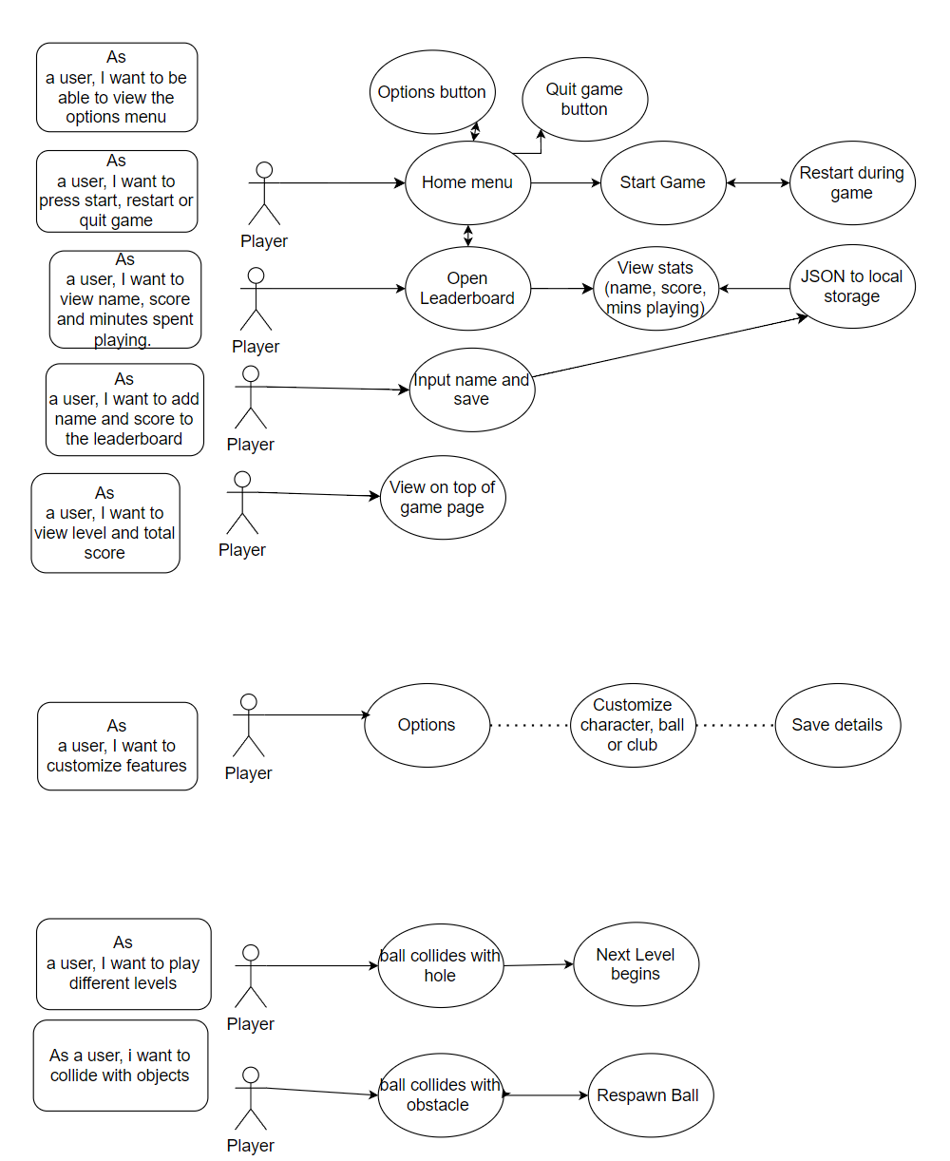
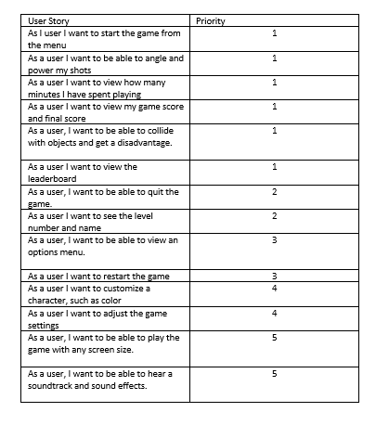
Project Plan

Slide 3
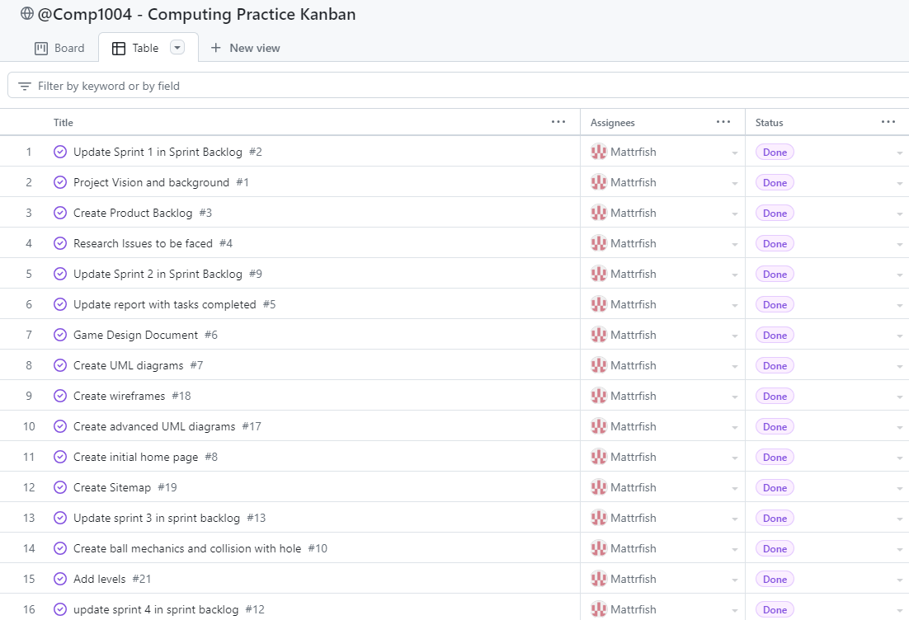
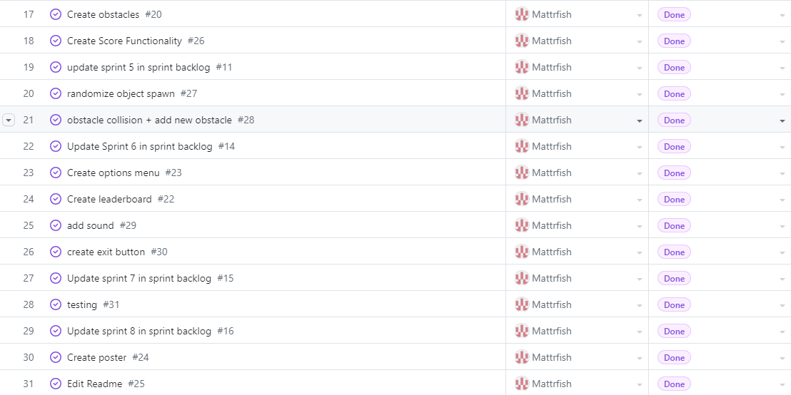
Project Plan (Kanban Board)

Slide 4
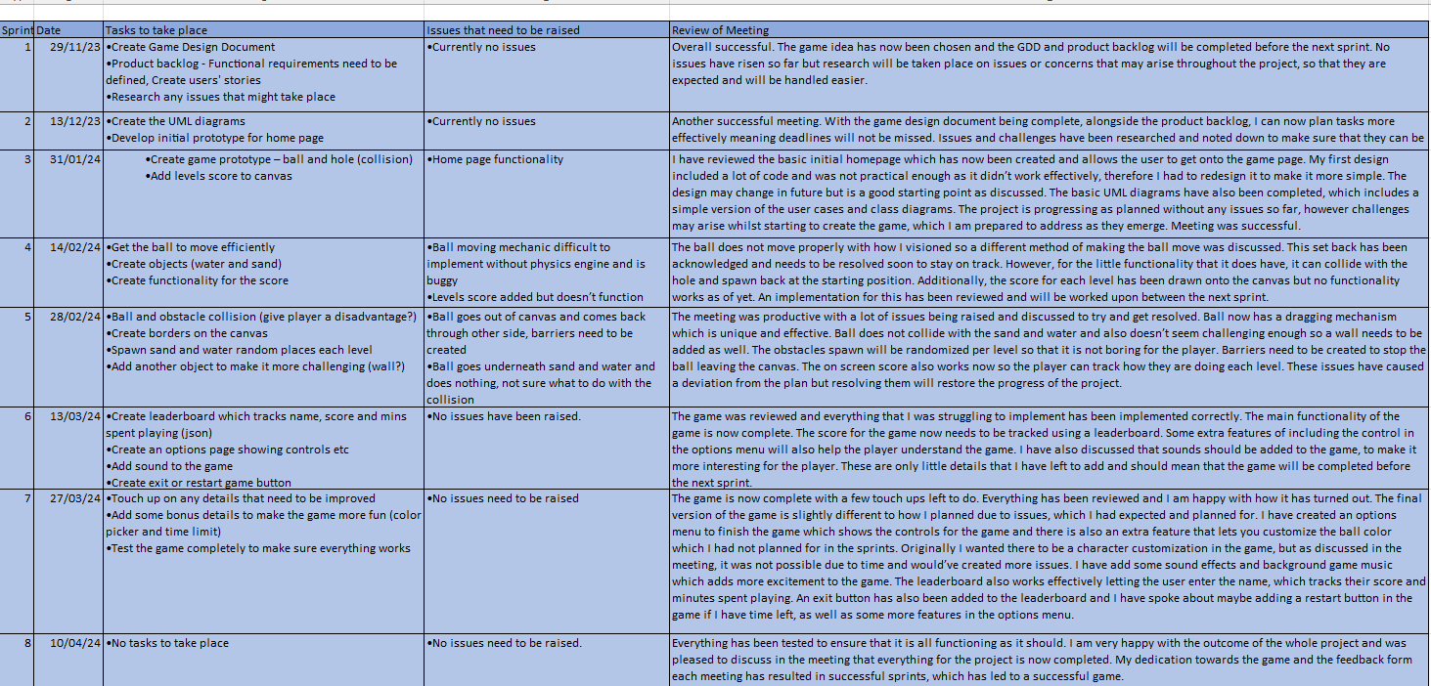
Sprints

Slide 5
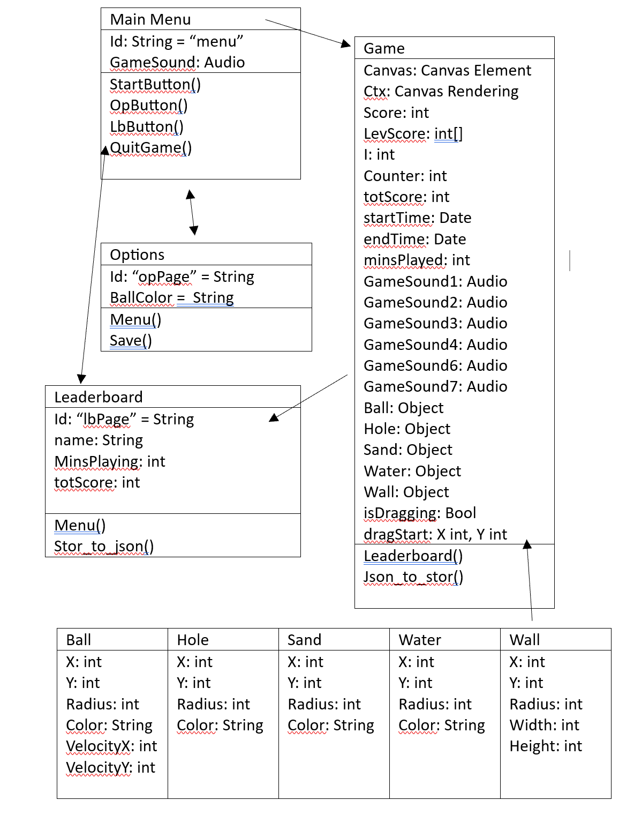
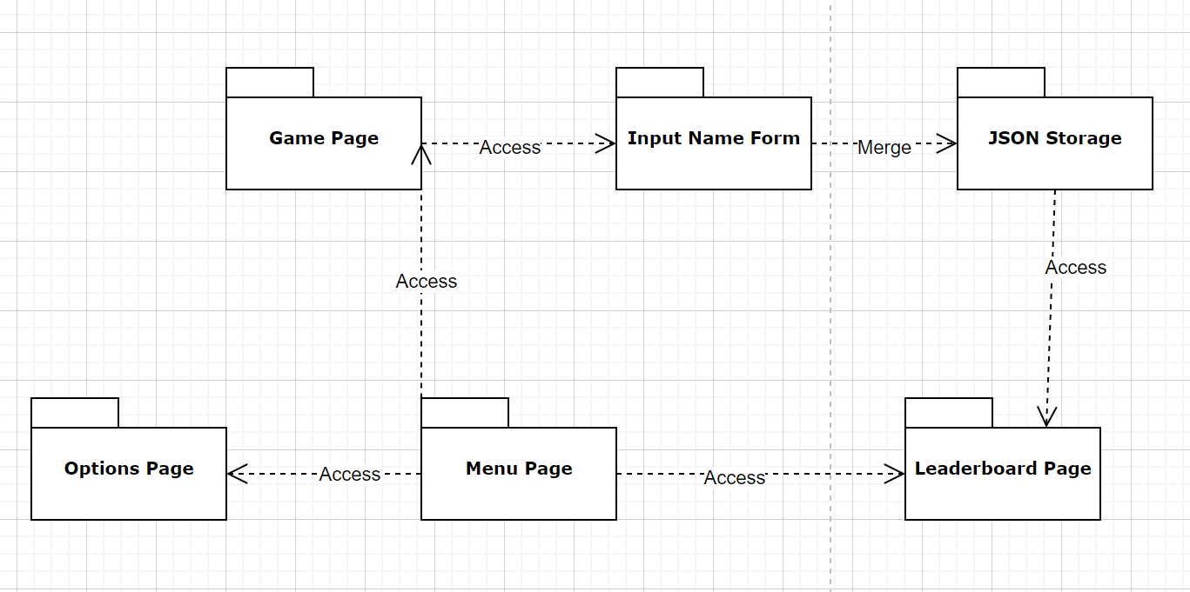
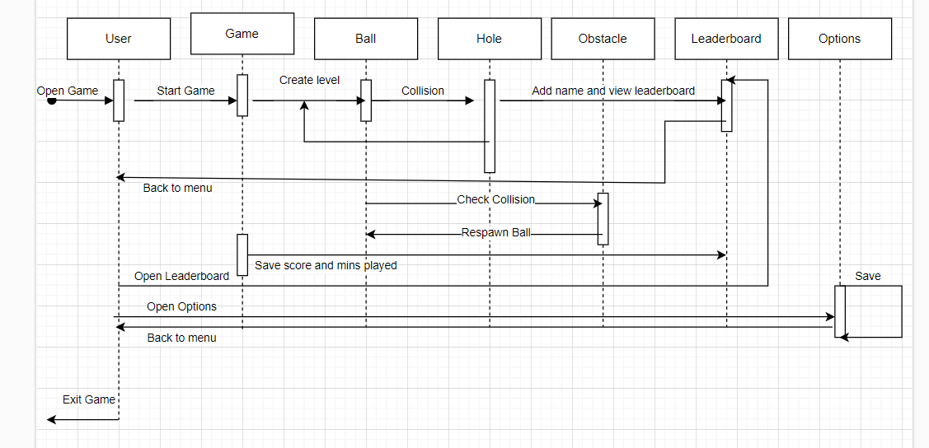
UML Diagrams

Slide 6
Issues and challenges faced
Kanban helped with outlining issues.
Features were implemented differently than planned.
Shooting mechanic was the biggest challenge.
Trial and error with issues.
Legal issues - Compliance with Copyright, Designs, and Patents Act 1998 and Data Protection Act 2018.
Social issues – Appropriate content.
Ethical issues – Providing honesty.

Slide 7
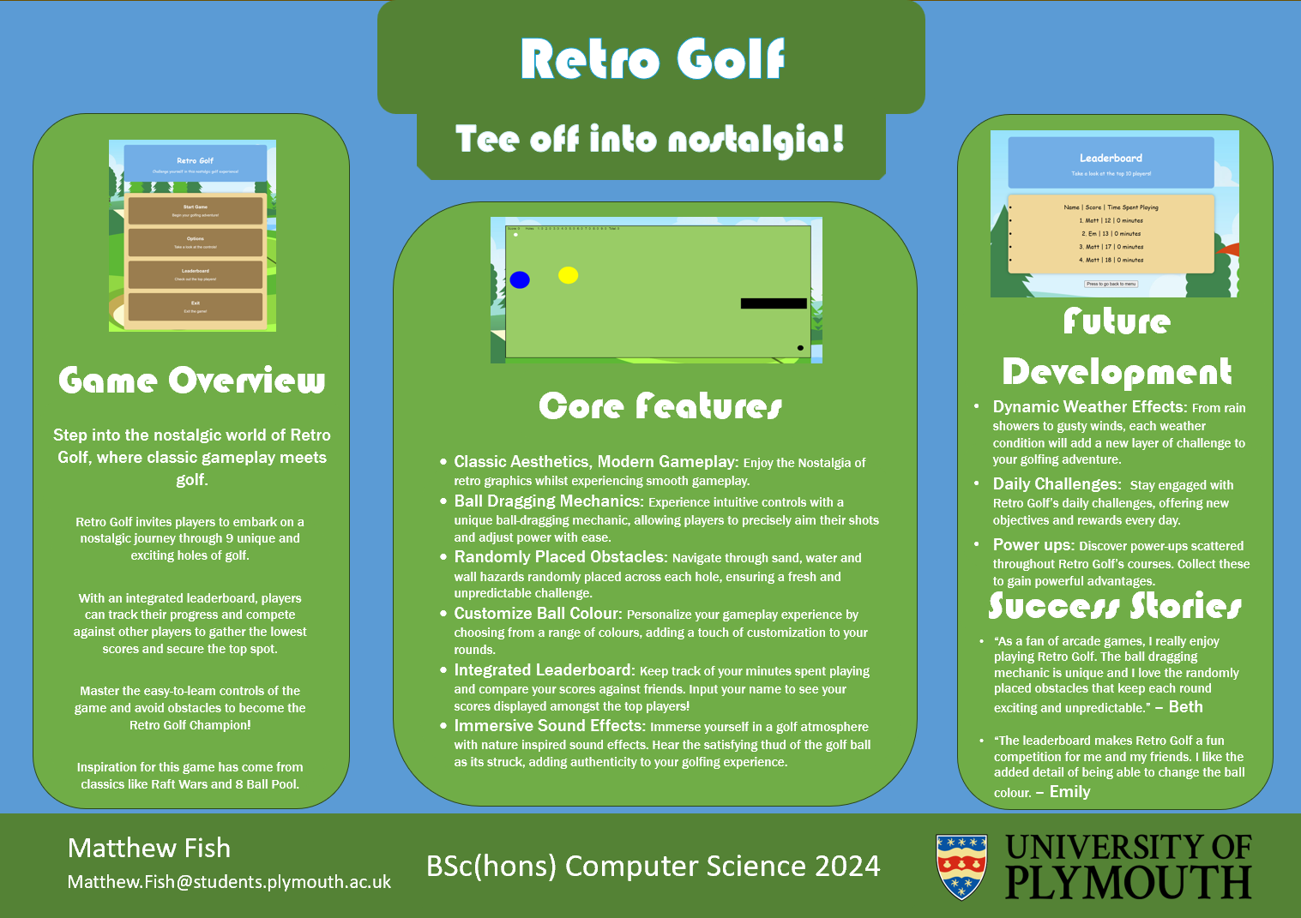
Poster

